Slide 1
Munkagård
4 different categories
300 students
"skoljordbruk"
Notes:
We are proud to welcome you to Munkagård, We have been going here for 3 years now and we will graduate now in 4 weeks with an education in agriculture.
Here on Munkagård School we have 4 different categories of education, We also have one of the biggest school agricultures in Sweden which gives us a big upside when it comes to practical experience.

Slide 2
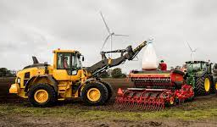
Agriculture
80 Dairy cows
80 Sows
200 hectare
A lot of practical experience
Notes:
The first thing you do when you go the agriculture education is to work with the agriculture at the school, in this period the students get to learn the base of the agriculture. The Second year we continue with different courses and in the spring we go out for 15 weeks of Practical experiences on other farms. When we come back for the third year we go deeper into the agriculture courses and get to choose individual courses such as service technique.

Slide 3
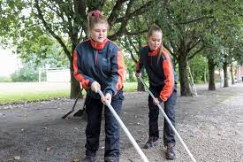
Gardeners
Wide education
They take care of the school park
15 weeks of practical experience
Notes:
The gardeners get a wide education where they learn to mow the lawn and build ponds. Munka have greenhouses and open field cultivation where they grow plants, vegetables and learns to do paving. They also take care of the school park which contains many different types of trees, flowers and herbs.
Munka have a clone archive which is part of the national genbank of apple, pear and plum from the western Sweden.

Slide 4
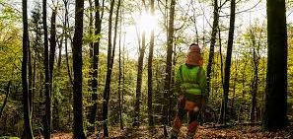
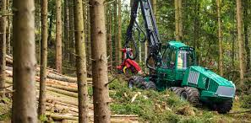
Forest
Manual labor
Machine labor
Most of the certifications
Notes:
Here at munka we teach the students all about the manual labor in the forest, how to handle a chainsaw, how to handle it safe and learn of to make it efficent. That also goes for the machine labor. We have 1 harvester and to bigger 2 forwarder and 1 smaller forwarder. The students get a lot of certifications that they need in the forest, the school offers the students a lot of other certifications to.

Slide 5
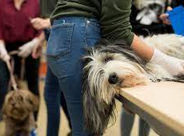
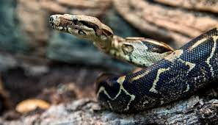
Animal care
Notes:
Here we have the animal care.
The animal care at the school consists of many animals,
In this categori of edukation you can bring your own dog if you want to specialize more in dogs.
The animal students have practical work and are allowed to work with these animals for 4 weeks. Then they are 2 weeks with the cows, 2 weeks with the pigs and 2 weeks with the animals in the animal care.
Then they have 15 weeks of practical work on examples farms, veterinary stations, shops or zoos. This Is a realy good posebility to coneckt to coworkes after gradiation.
Here are: hens, birds, snakes, insecs, fishes, turtles, rats, mices, hamsters.
Here are: rabbits and here are horses, sheeps, alpacas, mini kangroos and one mini pig.
If you study animal care, you can for example work whit veterinarians, zoo keepers, specialize in dogs, work in agriculture and zoo shops.

Slide 6
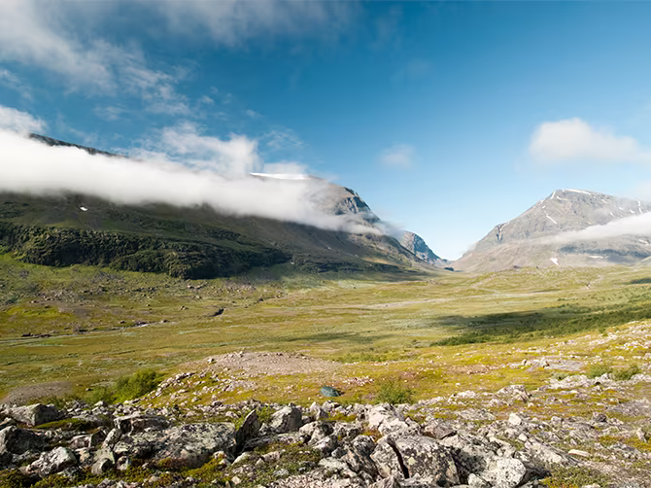
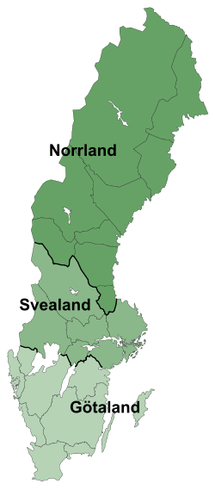
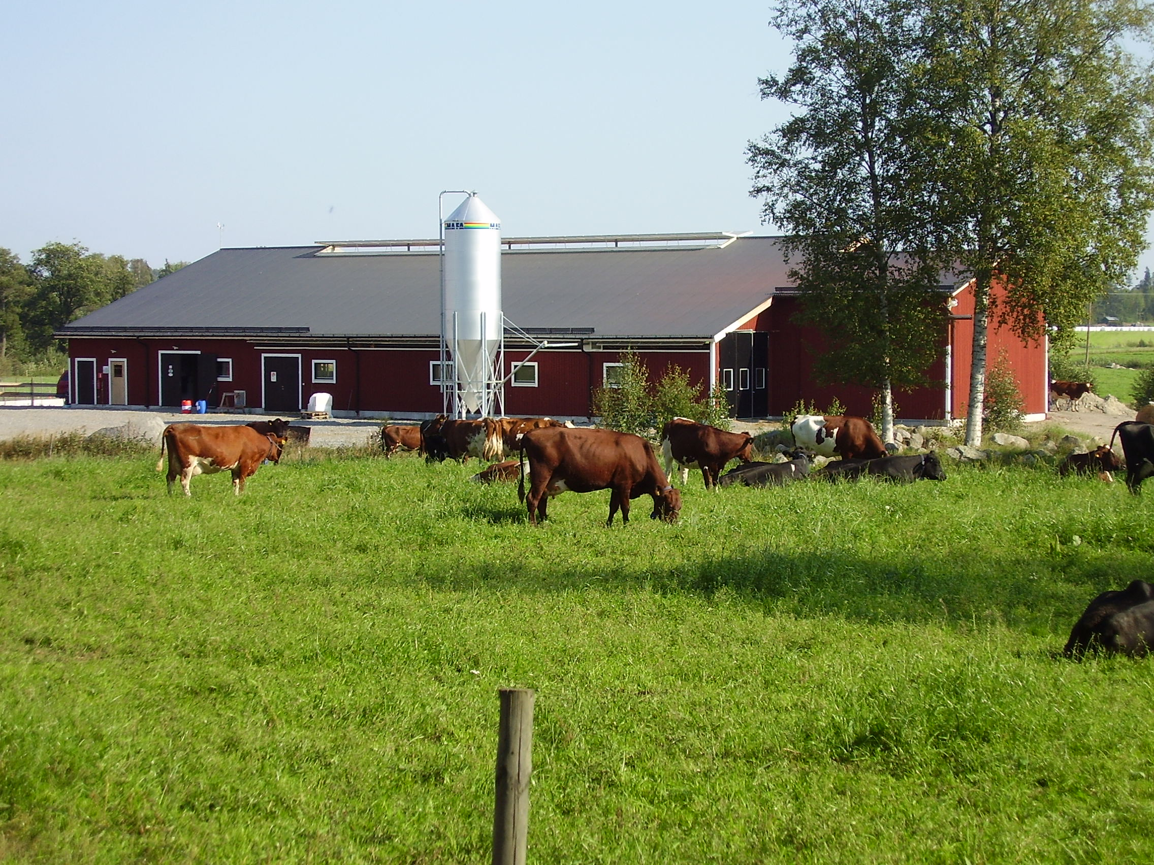
Swedish agriculture from north to south
Notes:
Sweden has different conditions from north to the south. To summarize it shortly to you there is much colder in the north (We have something that we call kalfjäll. It’s a cold climate where not much can grow, in this places we have a lots of reindeers.)
The more south you get you will find a bigger variation of crops and bigger fields, the possibilities to a larger production of all branches of animal production also gets bigger when you´re moving south through Sweden.

Slide 7
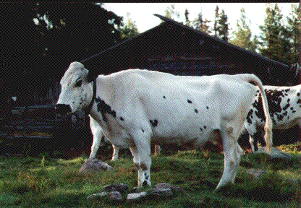
North of Sweden Västerbotten
-Shorter growing season
-Dairy cow production
-A lot of forest
-Samish culture
Notes:
Northern Sweden is the coldest part of Sweden and therefore the growing season is shorter than in the more southern parts of the country, about 3-4 months. Because of that, grains don’t grow as well there as they do here and the grains that grow in north is mostly barley and oat.
Grass is the most suited crop to grow and the midnight sun helps it grow. Midnight sun means that the sun is up both day and night, in other words around 24 hours, in the summertime. In the winter on the other hand it is night 24 hours, which means that the sun never rises.
About 75% of the fields are planted with grass. The grass fits perfectly in a cow diet and because of that cows are the most common farm animal in north.
In the northern Sweden there is also some Samish people that earns a living on reindeer farming. In the summer the reindeers roams freely in the mountains and forests and eats what they find.

Slide 8
Middle Sweden
What sort of crops
Dairy and beef cows
Less Winter crops
Hudiksvall
Notes:
In the middle of Sweden, the season of growing crops is a little bit longer than in the north but still a bit shorter than southern Sweden.
The main production is Dairy and Beef cows, the reason is that it’s a lot more suitable to grow silage, hay and spring crops because of the shorter season. The possibilities of that the crop is being Wintered is way to big so we prefer to not grow Winter crops.

Slide 9
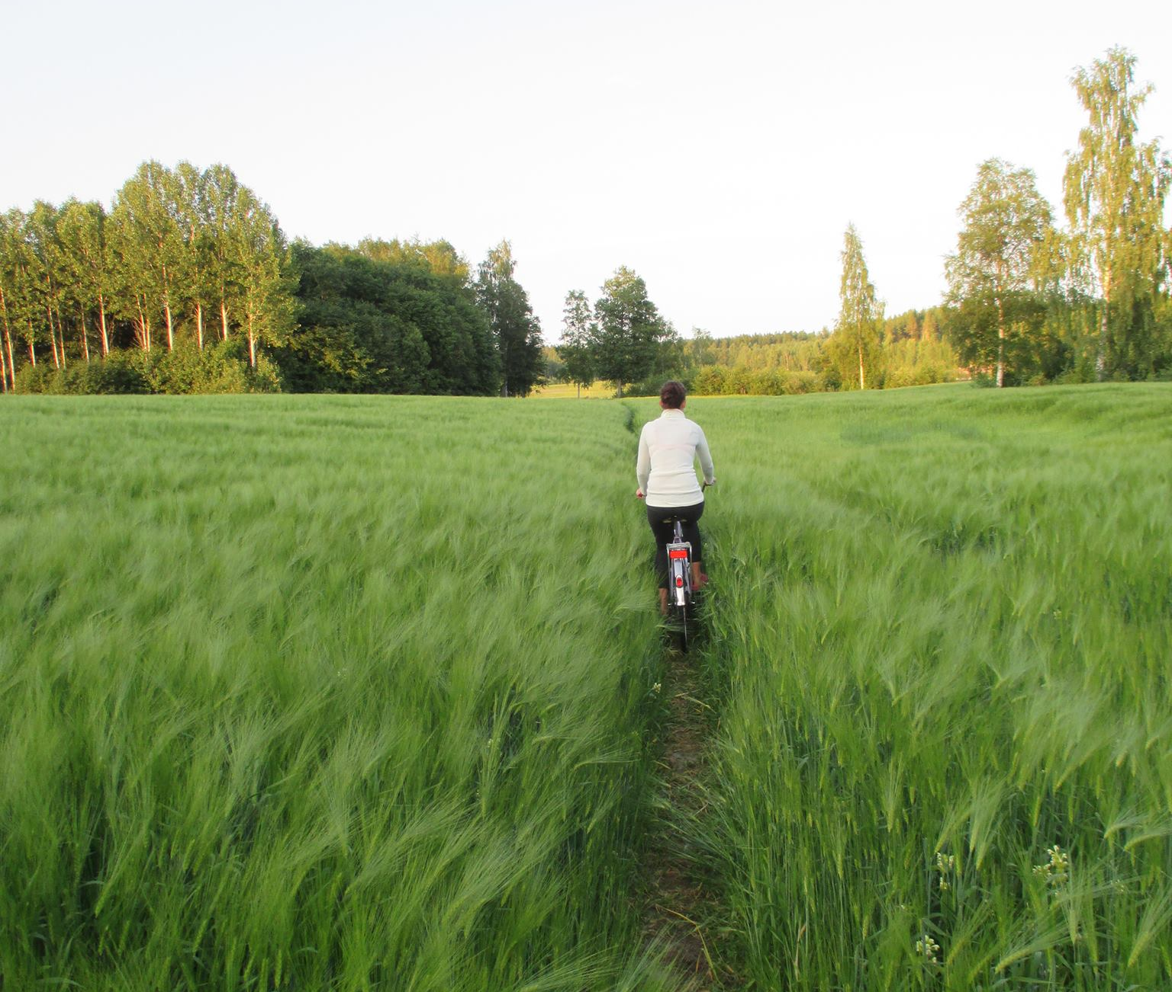
Example farm in Hudiksvall
Farm of 70 dairy cows
(70 milking)
Delaval robot
About 180 ha
-110 ha grass
-Whole grain and some barley
Notes:
We did take one example to show you how a farm could look in the middle of Sweden, This number of cows is a normal herd in this particular place of Sweden, 70 milking cows plus the recruitment animals and non milking cows...
This farm have a delaval robot to 70 milking cows,
In the most cases there is at most 60 cows to one robot which is the recommendation for the most of the robots. Most common robots is delaval and lely. And there is more common now days to have robots, but we have a lot of milking pits as well.
In this kind of farm you do often produce your own grass but you do often by other protein sources. (concentrates)
In today's situation the soja have been even more criticized, With unusually high prices on the market of protein the source of protein from our own land have been more important, such as field beans and canola.

Slide 10
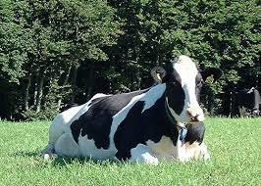
Halland
Milk production
High variation in soil types
Variation of crops
Notes:
We have good conditions for production of milk. Very nutritious grass for the silage that we feed our cows with, we can also harvest the grass a little longer than the north of Sweden.
In Sweden we have strict directions about antibiotic use, if you want to get vaccine to your own dairy cows that is possible to do if you have done a course which is both practical and theoretical use . As an example, you can treat mastit after this course) But otherwise you will have to get visit by a vet to set in a treatment.
The soil variates a lot here in Halland, for example here at this school it is a lot more sand in the soil than it is down south of Halland where I live, if we also drive 15 minutes away from here to a village nearby we have heavy clay.
In the north part of Halland we have mostly grass and down in the south there is a lot of annual crops because the conditions is perfect for it.

Slide 11
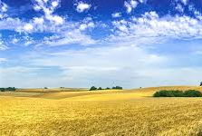
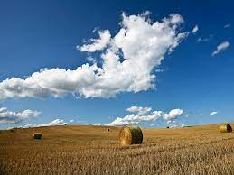
Mostly grain farms with pigs, similar to Denmark
Beets, potatoes and grain
Mostly bigger farms
Skåne south Sweden
Notes:
98% of the sugar beet harvest originates from Skåne. Just like southern Halland we grow a lot of annuell crops and this is why we have most pig production here.
The structure of the soil is very good, perfect soil for annual plants

Slide 12
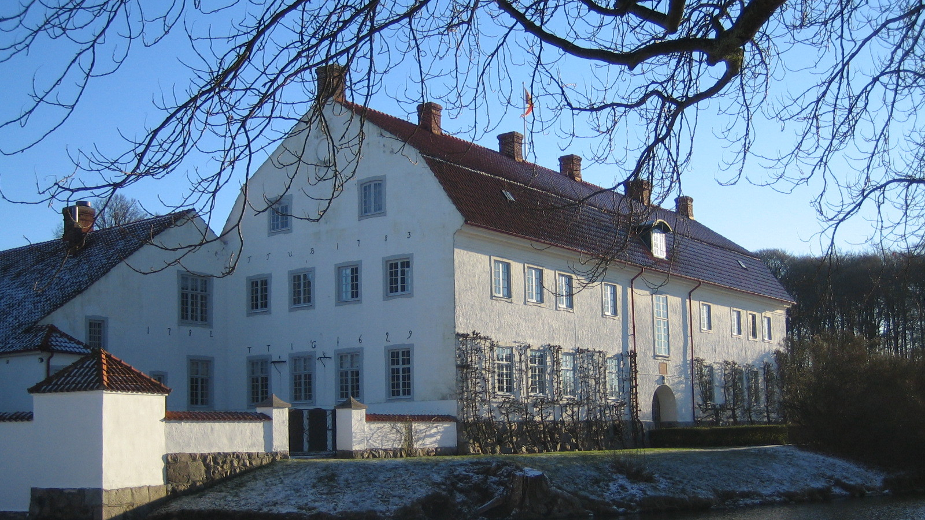
Skabernäs
Skabersjö agriculture
3200 hectare of arable land
2000 hectare of productive forest
Notes:
The company farms about 3200 hectare with combined with other companys, one of them are Skabernäs, a big farm in skåne .
They also have about 2000 hectare forest that are in productive use

Slide 13
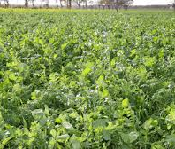
Intermediate crops
Value of the crop depence on where you farm it
It´s good as a change when you have a crop rotation with less grassland
Notes:
Intermediate crops has different value for different farmers, for a farmer that farm in southern Sweden the intermediate crops could have a big value because the autum growth is better than in the norther Sweden where the crop doesn´t get the time to grow enough.
It´s also most important for the farmers who grow a lot of grains and less silage because you let the ground fill up with organic matter and you reduce the risk of erosion.
cover crop

Slide 14
Thanks!
Notes:
We alweys keep the envirement in ouer mind In every categary in this scool in every subjekt!
Tanks for lissning and hope you have a good time her in Sweden whit us!

